Slide 1

Using Multilinear Regression of Publicly-Provided NAM Forecast Data to Develop Site-Specific Wind and Temperature Models
Project 4 (Final Project)
Steph Abegg

Slide 2

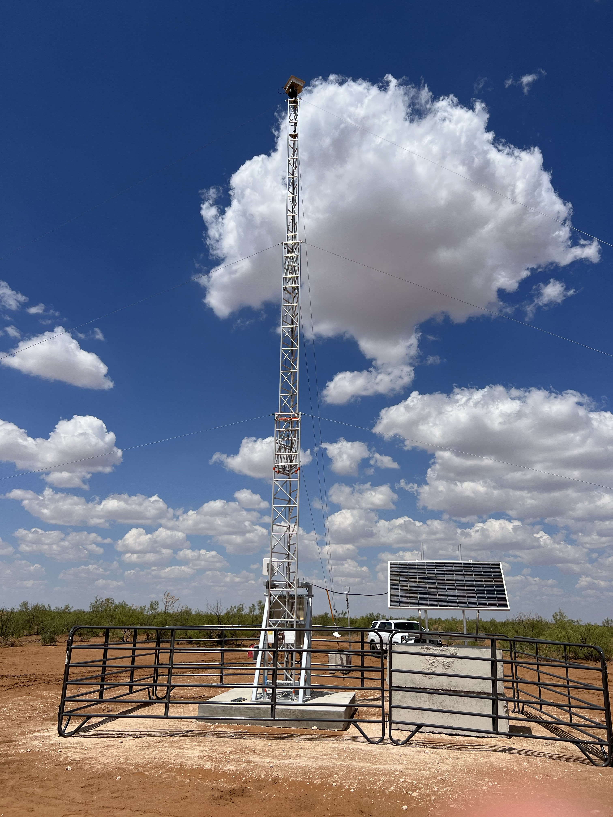
LongPath Technologies, Inc.
Innovative laser-based continuous monitoring of methane emissions.
Based in Boulder, CO. I’ve worked there since 2022.
“We install and maintain continuous laser line sensors to supply real-time emissions monitoring data and actionable insights for our clients. We work with oil and gas operators across the energy landscape and provide expanded services to various markets.”
“Only LongPath Technologies delivers high-frequency readings, low detection limits, and best-in-class emission rate quantification.”
https://www.longpathtech.com/
Laser telescope for measuring methane concentrations

Slide 3
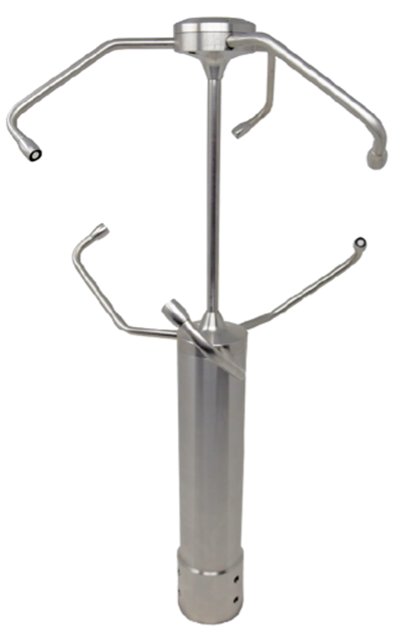
LongPath Technologies
LongPath measures methane emissions by finding the difference in measured methane concentration on either side of a site, and computing a plume model based on these concentration measurements and factors such as wind speed, wind direction, and temperature.
LongPath uses on-site 3D ultrasonic anemometers.
However, during the winter the 3D anemometers are prone to icing up. The system is down when there is no wind data.
3D anemometer

Slide 4
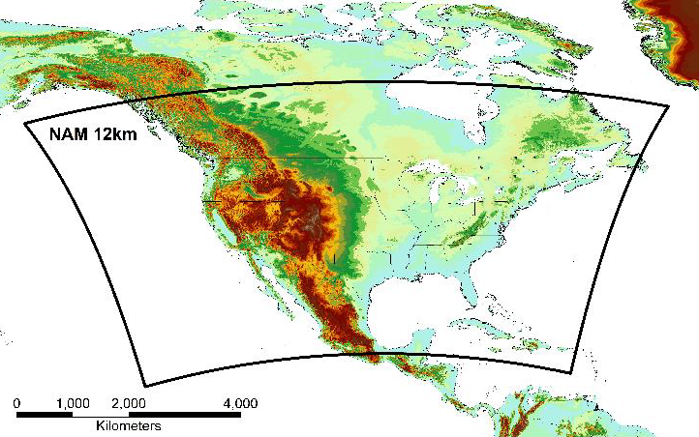
Research Questions
Is forecast data a good proxy for anemometer data?
Can publicly-provided forecast data, such as from the North American Mesoscale (NAM) Forecast System, be used as a proxy for the anemometer data during the times when the anemometer is down?
Does a multilinear regression trained on forecast data provide an even better proxy for anemometer data?
Can a multilinear regression model trained on the NAM data can provide even better site-specific predictions of the wind and temperature conditions than the direct NAM forecasts alone?
NAM 12-km grid
3D anemometer

Slide 5
The Data
Anemometer Data
Data from a 3D anemometer located in North Dakota.
Data spans 30 days from Feb 11 to March 11, 2024. Four days missing due to iced up anemometers.
Anemometer measures on five-second intervals. Data averaged into 15-minute intervals.
The raw data contains 420,917 rows. Data averaged into 15-minute intervals had 2344 rows.
Lots of data cleaning (removing bad data, renaming columns, changing units, adding local time, ….)
NAM Forecast Data
NAM forecast data downloaded from the government website for the same time frame.
NAM data is released every 6 hours, providing forecasts for 0, 1, 2, 3, 4, 6, 12, 24, 48, 72 hours.
A python script was written to download the data, extract the desired information for the location of interest, and save into .csv files.

Slide 6
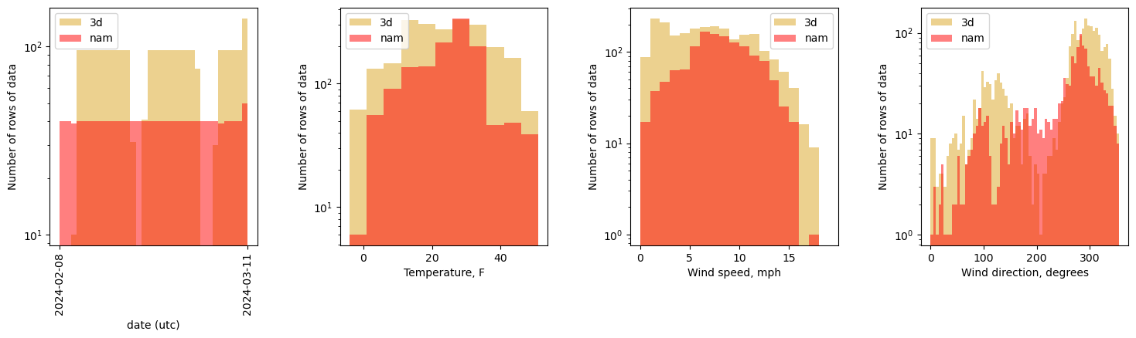
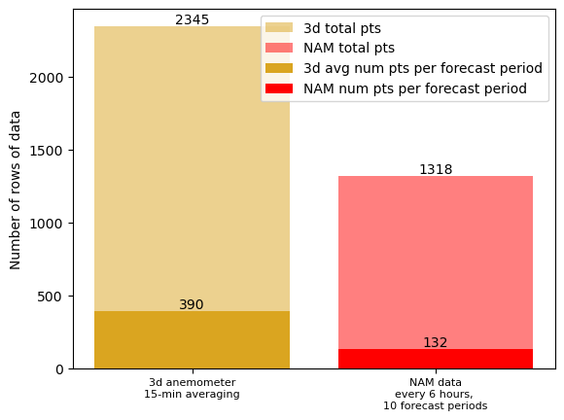
Analysis : Direct Comparison of Anemometer and NAM
Above: Histograms of the 15-minute averaged 3D anemometer data and the NAM forecast data.
Right: Number of rows of data in the joined dataframe. For any given forecast period, there are about four times as many 3D anemometer measurements (ideally there would be exactly four times as many, but there were a couple of time periods when the anemometer was iced up).

Slide 7
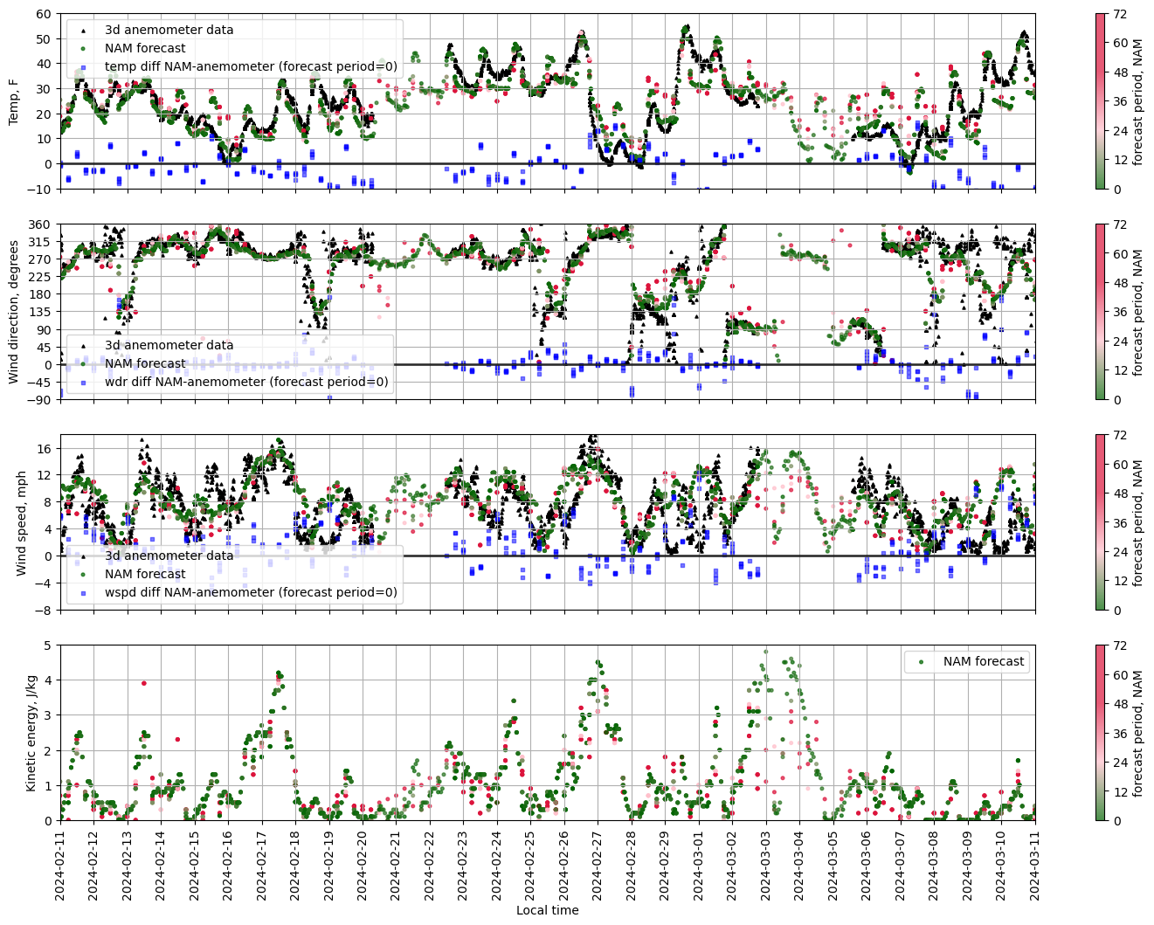
Analysis : Direct Comparison of Anemometer and NAM
NAM forecast data and 3D anemometer data (15-minute averaged) for temperature, wind direction, and wind speed. The difference (NAM-anemometer) is shown in blue. The NAM forecast data is color-coded by forecast period, where green represents a forecast of half a day or less, and red represents a forecast of up to 1-3 days.

Slide 8
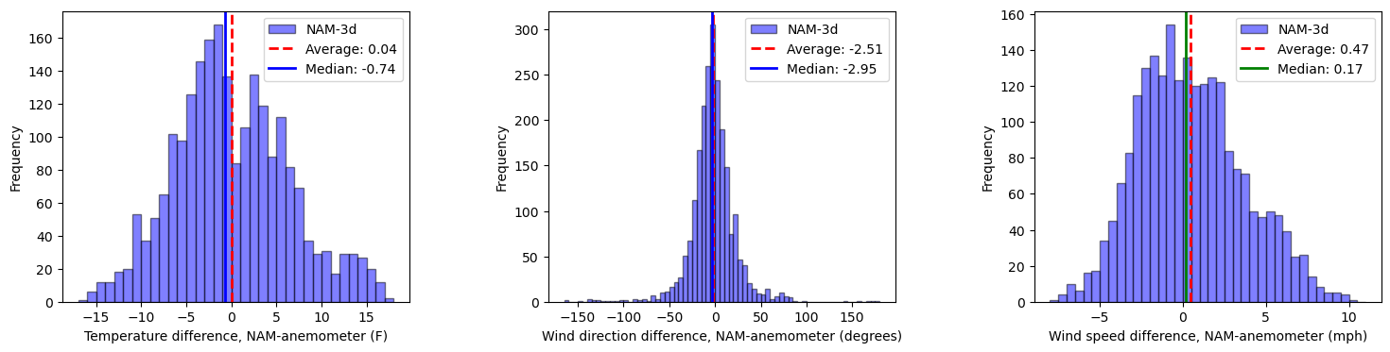
Analysis : Direct Comparison of Anemometer and NAM
Histograms of the difference between the NAM forecast data and 3D anemometer 15-minute averages for the same 15-minute windows. The forecast period is limited to 0-12 hours and the wind speeds > 1m/s (2.24 mph).

Slide 9
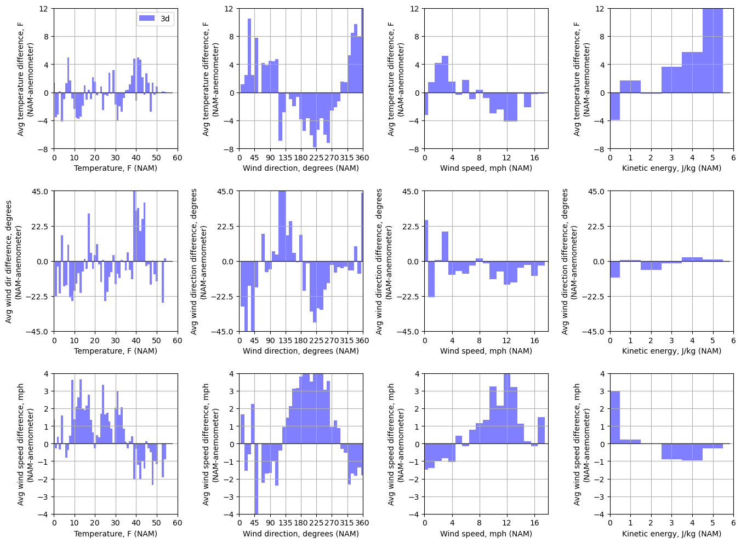
Analysis : Direct Comparison of Anemometer and NAM
Average temperature difference, wind direction difference, and wind speed difference (NAM-anemometer) per binned temperature, wind direction, wind speed, and kinetic energy of NAM forecast. The forecast period is limited to 0-12 hours to remove inaccuracies from longer-term forecasting.

Slide 10
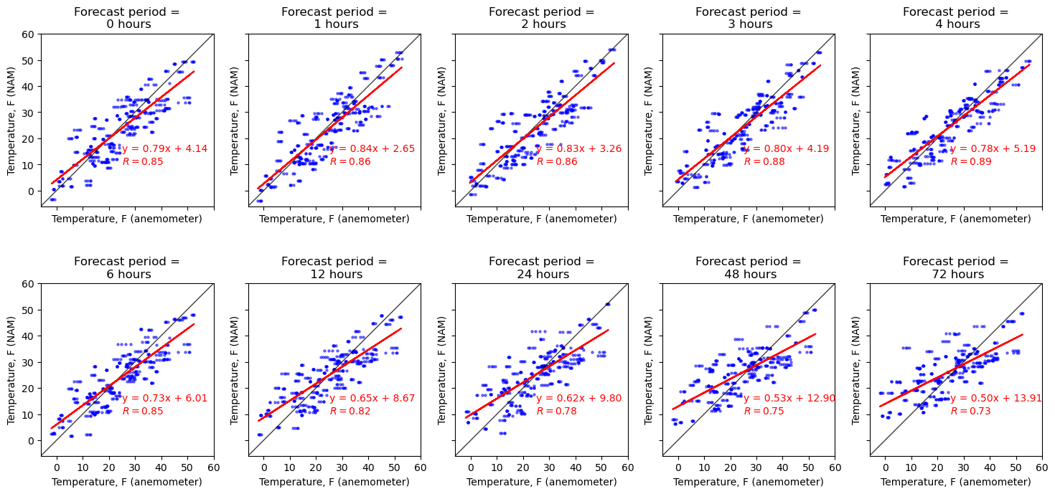
Analysis : Direct Comparison of Anemometer and NAM
Linear regression of NAM forecasted temperature versus the 3D anemometer temperature measurements.

Slide 11
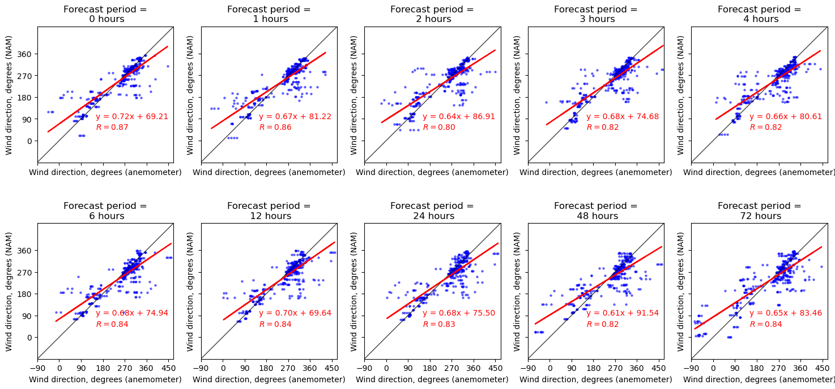
Analysis : Direct Comparison of Anemometer and NAM
Linear regression of NAM forecasted wind direction versus the 3D anemometer wind direction measurements.

Slide 12
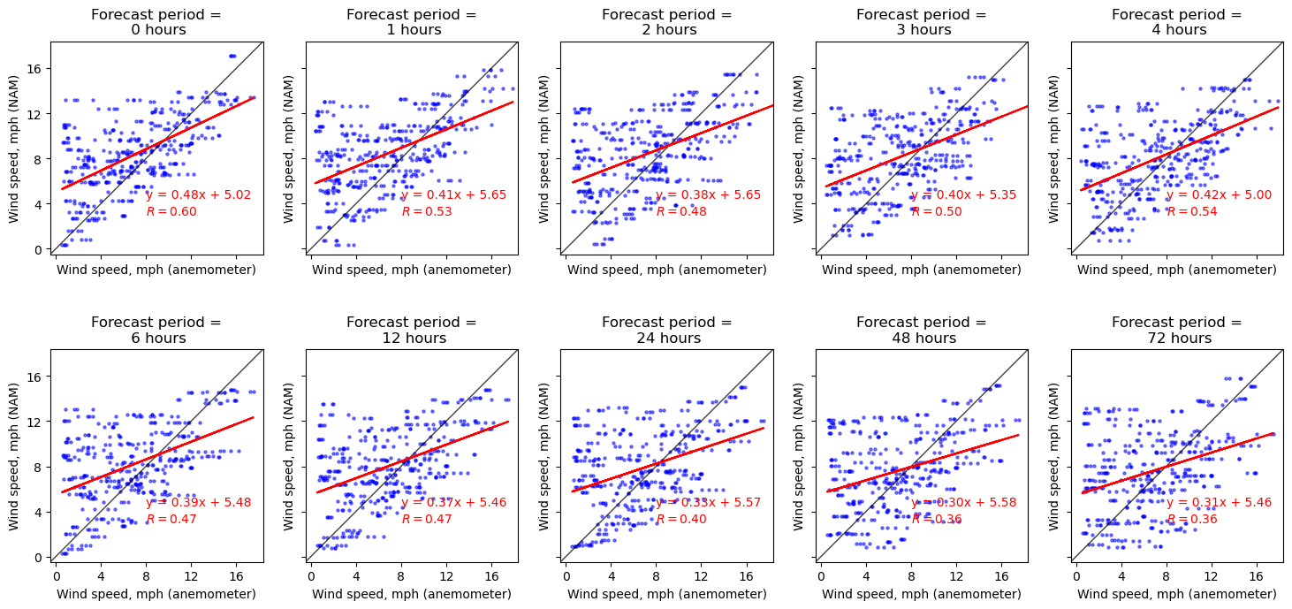
Analysis : Direct Comparison of Anemometer and NAM
Linear regression of NAM forecasted wind speed versus the 3D anemometer wind speed measurements.

Slide 13
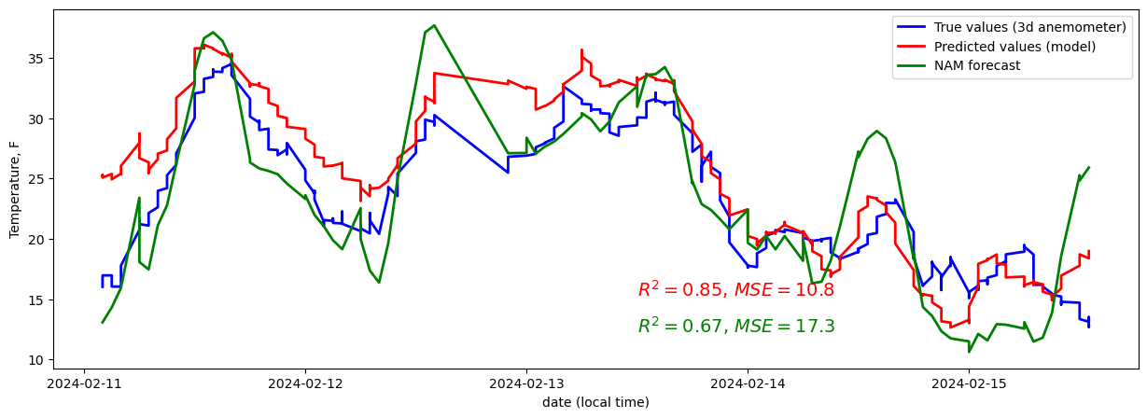
Analysis : Multilinear Regression to Model Site-Specific Conditions Better than Direct NAM Forecast
Model values and NAM forecast values and 3D anemometer measurements of temperature. The model has a higher R² value and lower MSE than the NAM forecast.

Slide 14
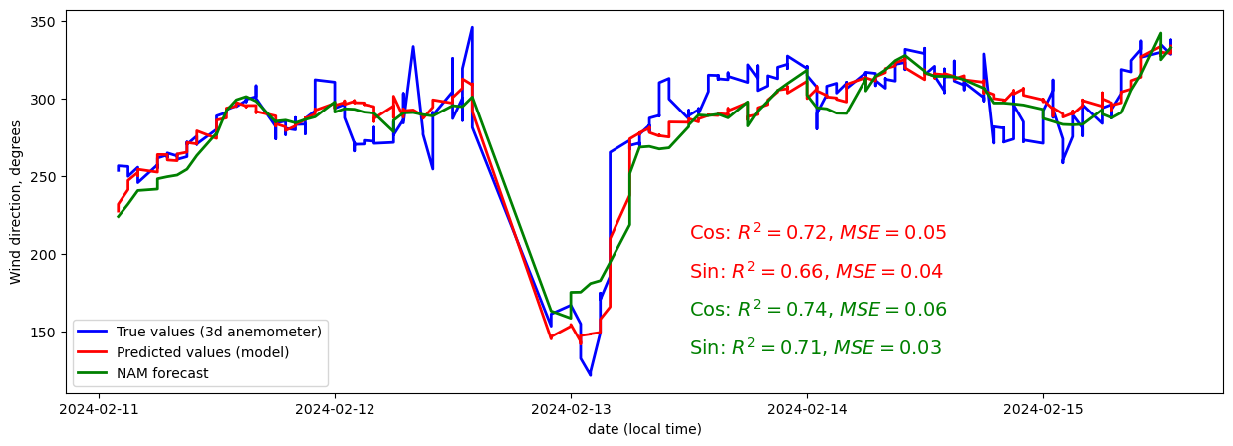
Analysis : Multilinear Regression to Model Site-Specific Conditions Better than Direct NAM Forecast
Model values and NAM forecast values and 3D anemometer measurements of wind direction. The model and NAM forecast had roughly the same R² and MSE values.

Slide 15
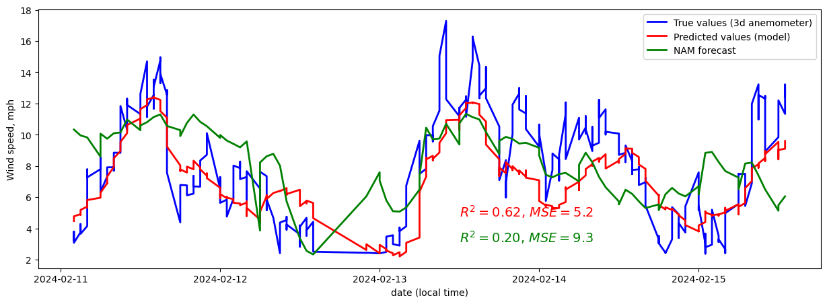
Analysis : Multilinear Regression to Model Site-Specific Conditions Better than Direct NAM Forecast
Model values and NAM forecast values and 3D anemometer measurements of wind speed. The model has a higher R² value and lower MSE than the NAM forecast.

Slide 16
Analysis : Multilinear Regression to Model Site-Specific Conditions Better than Direct NAM Forecast
R² and MSE values for the multilinear regression models. The higher R² and lower MSE values are highlighted in green.
 | Temperature, F | Wind direction, cos | Wind direction, sin | Wind speed, mph
R-value model prediction | 0.92 | 0.85 | 0.81 | 0.79
R-value NAM forecast | 0.82 | 0.86 | 0.83 | 0.44
R² model prediction | 0.85 | 0.72 | 0.66 | 0.62
R² NAM forecast | 0.67 | 0.74 | 0.71 | 0.20
MSE model prediction | 10.76 | 0.048 | 0.036 | 5.23
MSE NAM forecast | 17.25 | 0.058 | 0.027 | 9.29

Slide 17
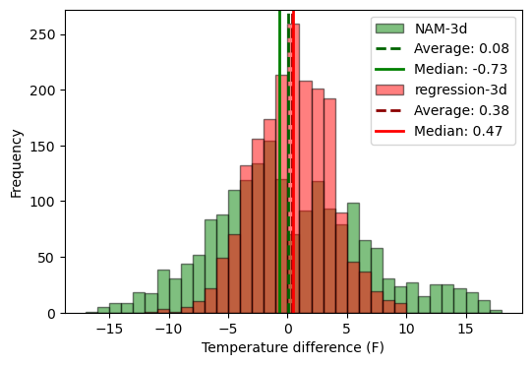
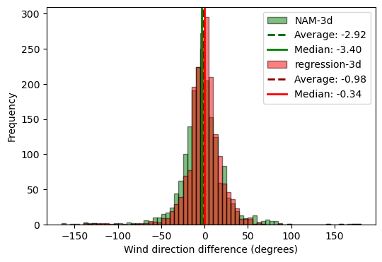
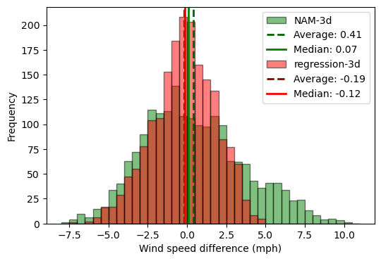
Analysis : Multilinear Regression to Model Site-Specific Conditions Better than Direct NAM Forecast
Histograms of the differences between the NAM data and the 3d anemometer and the regression prediction and the 3d anemometer. The forecast period is limited 1-12 hours and the wind speeds > 1m/s (2.24 mph). For all three dependent variables, the multilinear regression model gives a tighter histogram, with fewer large differences between the predicted and actual values. (The NAM-3d is the same data as in Figure 6 histograms for NAM-3d.)

Slide 18
Analysis : Multilinear Regression to Model Site-Specific Conditions Better than Direct NAM Forecast
Variable (Standardized) | Temperature, F | Wind direction, cos | Wind direction, sin | Wind speed, mph
temp_F_nam | 4.46 | -0.17 | -0.08 | 0.19
wdr_cos_nam | -0.89 | 0.12 | -0.01 | -0.06
wdr_sin_nam | -0.57 | -0.19 | 0.29 | -0.17
wspd_mph_nam | 1.33 | -0.16 | -0.13 | 0.31
forecast_period | 0.04 | 0.00 | -0.03 | -0.06
welv_nam | 0.00 | 0.02 | 0.00 | 0.04
kinetic_e | -1.13 | 0.12 | 0.10 | 0.36
hour_forecasted_cos | -0.33 | 0.02 | 0.04 | -0.87
hour_forecasted_sin | 0.75 | 0.03 | 0.00 | -0.48
day_of_year_forecasted | -0.63 | 0.03 | -0.03 | 0.07
temp_F_nam_lag_b1 | 2.24 | 0.00 | 0.01 | -0.03
temp_F_nam_lag_b2 | 1.20 | 0.00 | 0.06 | -0.17
temp_F_nam_lag_f1 | 2.30 | -0.04 | 0.02 | -0.09
temp_F_nam_lag_f2 | 2.91 | 0.16 | 0.00 | -0.39
wdr_cos_nam_lag_b1 | -0.46 | 0.06 | 0.04 | 0.22
wdr_cos_nam_lag_b2 | -0.03 | 0.17 | -0.03 | 1.07
wdr_cos_nam_lag_f1 | -0.40 | 0.05 | -0.05 | -0.18
wdr_cos_nam_lag_f2 | -0.35 | -0.02 | -0.03 | -0.41
wdr_sin_nam_lag_b1 | 0.20 | -0.06 | 0.23 | 0.39
wdr_sin_nam_lag_b2 | 0.68 | 0.08 | 0.15 | 1.03
wdr_sin_nam_lag_f1 | -0.54 | 0.04 | 0.02 | -0.11
wdr_sin_nam_lag_f2 | -1.04 | 0.02 | -0.07 | -0.62
wspd_mph_nam_lag_b1 | 1.06 | 0.04 | -0.02 | -0.01
wspd_mph_nam_lag_b2 | 0.79 | 0.07 | -0.05 | 0.24
wspd_mph_nam_lag_f1 | 1.27 | -0.09 | 0.00 | 0.56
wspd_mph_nam_lag_f2 | 1.41 | 0.09 | 0.07 | 0.01
kinetic_e_lag_b1 | -1.04 | -0.04 | -0.01 | 0.57
kinetic_e_lag_b2 | -0.46 | -0.04 | -0.04 | 0.20
kinetic_e_lag_f1 | -1.45 | 0.08 | 0.01 | 0.25
kinetic_e_lag_f2 | -1.62 | -0.06 | -0.01 | 0.62
Coefficients for standardized variables for multilinear regression models. For a given model, coefficients with a higher magnitude have a greater predictive power on the output. The gradient coloring highlights the coefficients with greater predictive power (darker) in each of the models. Green indicates a positive effect while red indicates a negative effect.

Slide 19
Conclusions
Is forecast data a good proxy for anemometer data?
Based on this analysis, the NAM forecast data for temperature, wind direction, and wind speed has a moderately strong correlation with the anemometer measurements. There is enough scatter that the NAM data is likely not viable as a direct replacement of the anemometer data on a 15-minute time frame. The NAM forecast could be used to predict such things as plume movement, for example, over time.
Does a multilinear regression trained on forecast data provide an even better proxy for anemometer data?
While the direct NAM forecast may not be a sufficient consistent proxy for anemometer data, predictions based off a site-specific trained multilinear regression model of the publicly-provided NAM forecast data might be, at least during times when the anemometers are inoperable and when the wind speeds are high enough. In this study, multilinear regression models were developed to predict temperature, wind direction, and wind speed at the site of the 3D anemometer. The predicted temperatures and wind speeds offered significantly better correlation and fewer large differences with the actual measurements than the direct NAM forecasts of temperature and wind speed, while the predicted wind directions were about the same. Both the direct NAM forecasts and the models offer the best predictions when the wind speed is above 1m/s. However, there is still enough variation in the site-specific conditions that is not captured by the models that the model predictions are not good enough to just replace the use of anemometers altogether.

Slide 20
?

